Slide 1
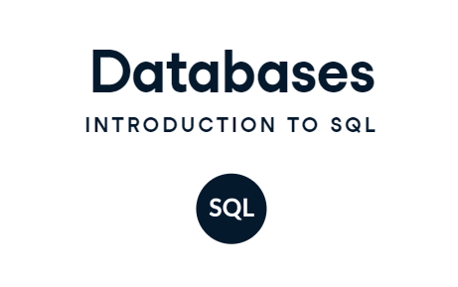
Lab # 01

Slide 2
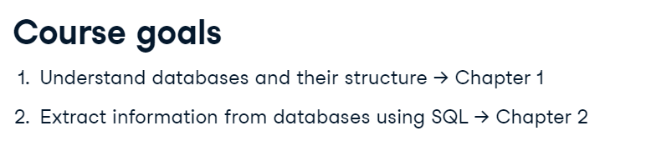
Today’s Agenda

Slide 3
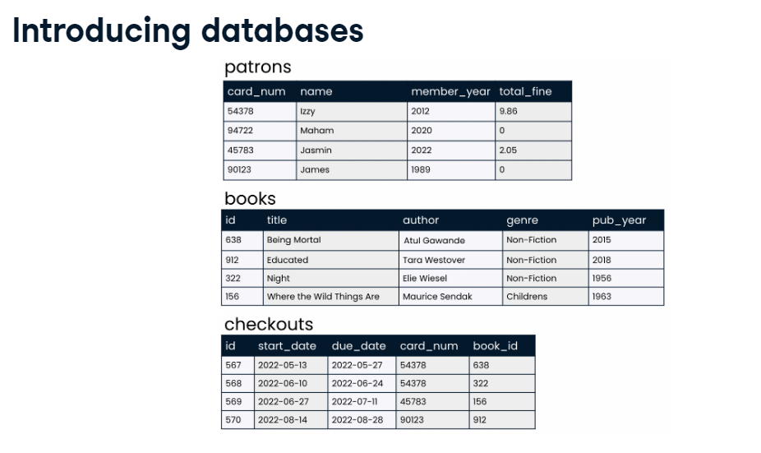

Slide 4
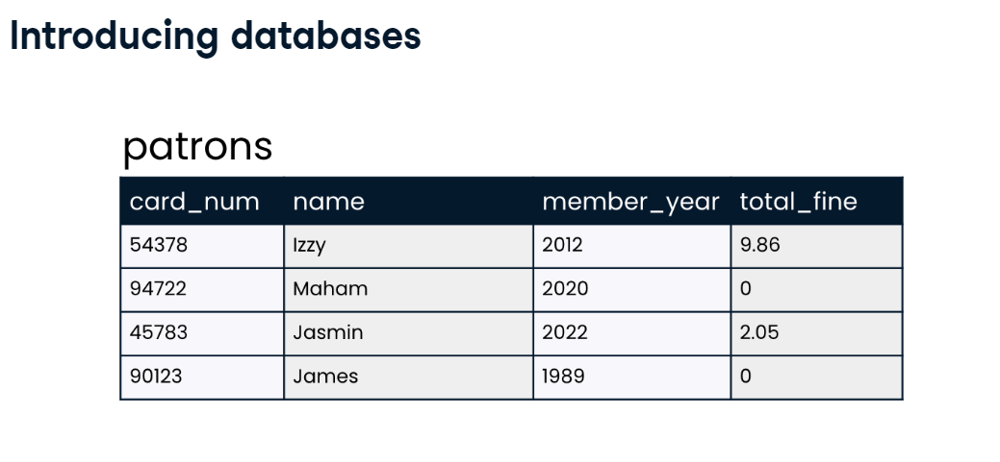

Slide 5
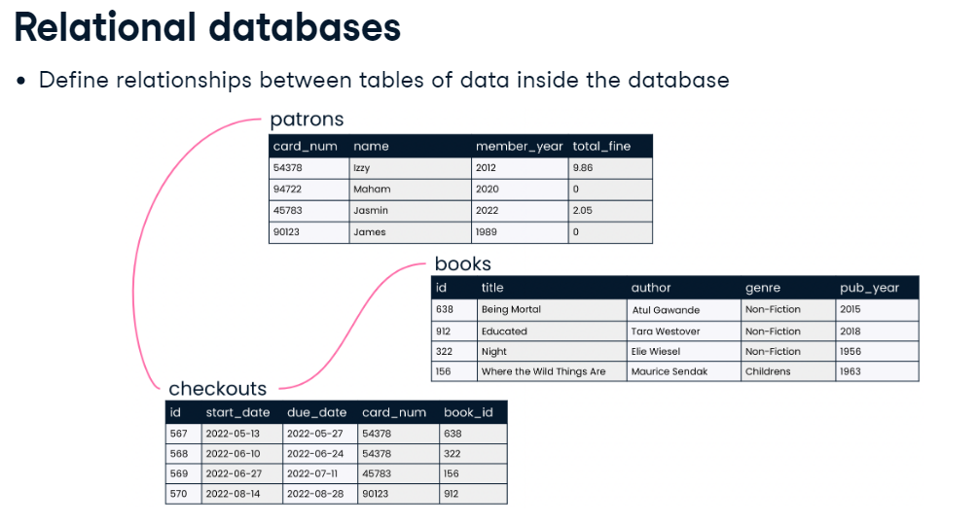

Slide 6
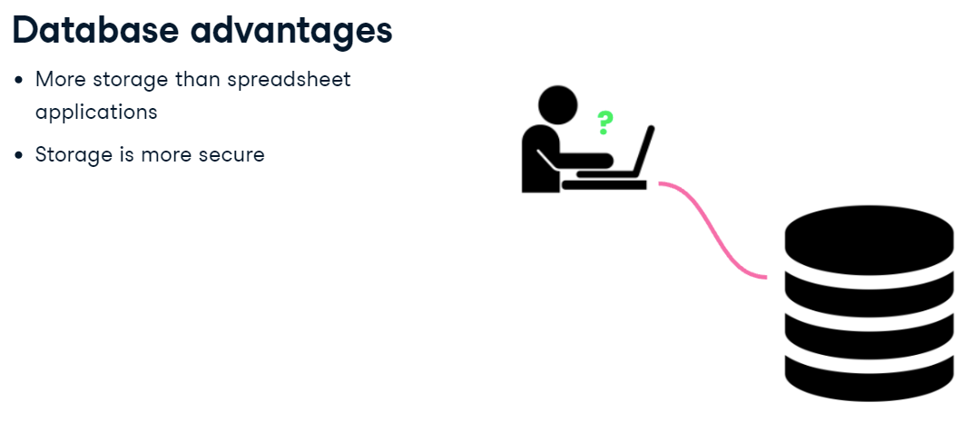

Slide 7
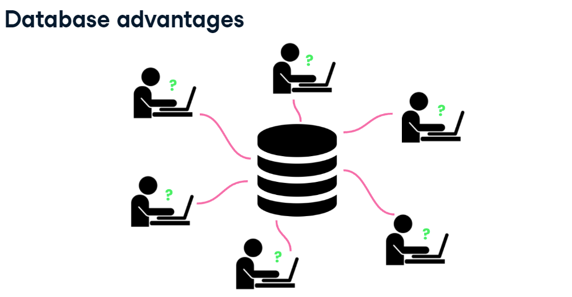

Slide 8
Theory: DB & DBMS
What is a database?
A database is an organized collection of data.
What is a Database Management System?
Database management systems (DBMSs) are specially designed software applications that interact with the user, other applications, and the database itself to capture and analyze data.

Slide 9
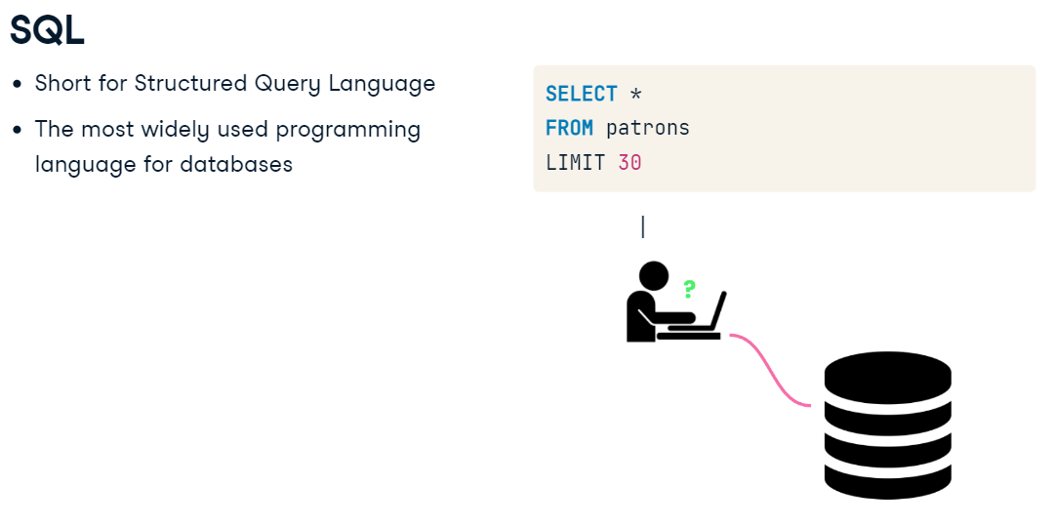

Slide 10
Examples :What Can SQL do?
SQL can execute queries against a database
SQL can retrieve data from a database
SQL can insert records in a database
SQL can update records in a database
SQL can delete records from a database
SQL can create new databases
SQL can create new tables in a database
SQL can create stored procedures in a database
SQL can create views in a database
SQL can set permissions on tables, procedures, and views

Slide 11
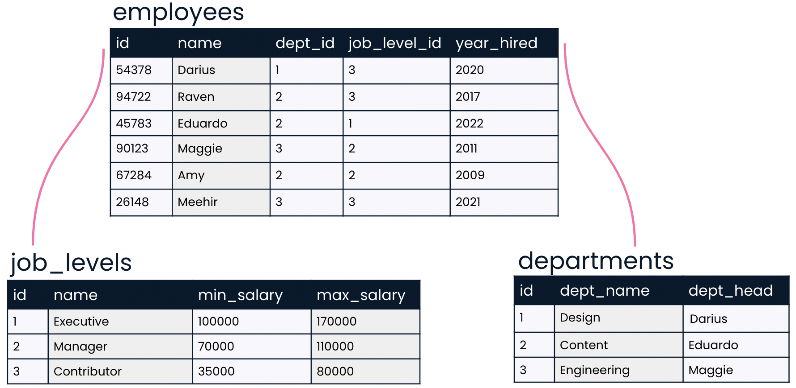
Quick Quiz # Data organization
If you'd like to use SQL to gain insights from data, understanding the organization of a database is an important first step. Take a look at the database below. Which of the following statements correctly describes its organization?
OPTIONS
This is a table containing three relational databases: employees, job_levels & departments
This is a relational database containing three tables: employees, job_levels & departments
This is a database, but it is not relational, because no relationship exists between job levels and departments
This is not a database because there is no SQL code shown.

Slide 12
Quick Quiz # Database advantages:
Imagine you are part of a discussion at work about whether or not to create a database. You've learned about several advantages of storing data in a database rather than other traditional formats like spreadsheets. See if you can remember what they are!
Secured with encryption.
More storage
Can see all data at once
Fast & easy Step
Many Peoples can use at once

Slide 13
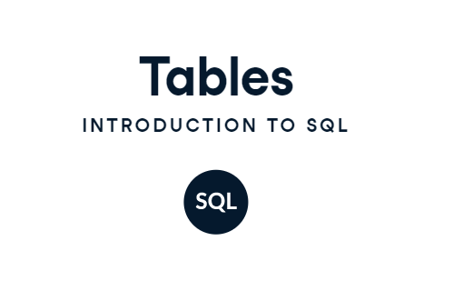

Slide 14
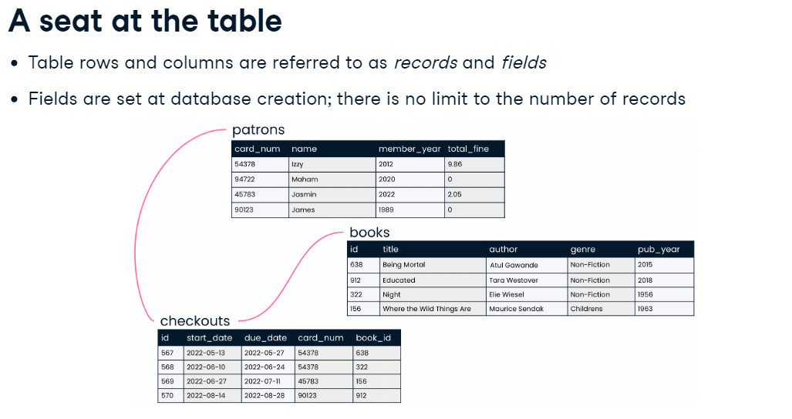

Slide 15
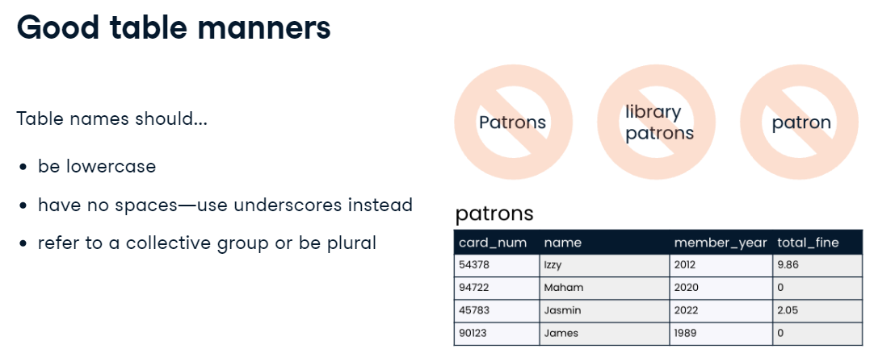

Slide 16
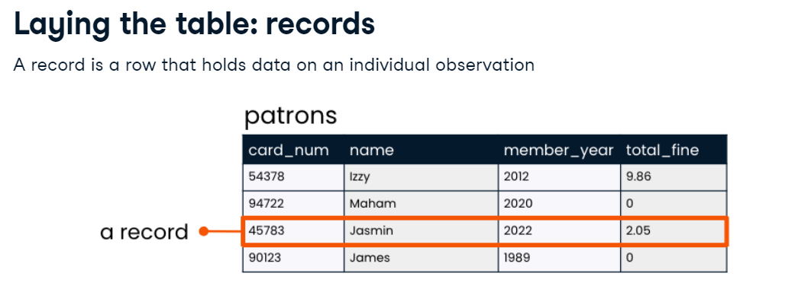

Slide 17
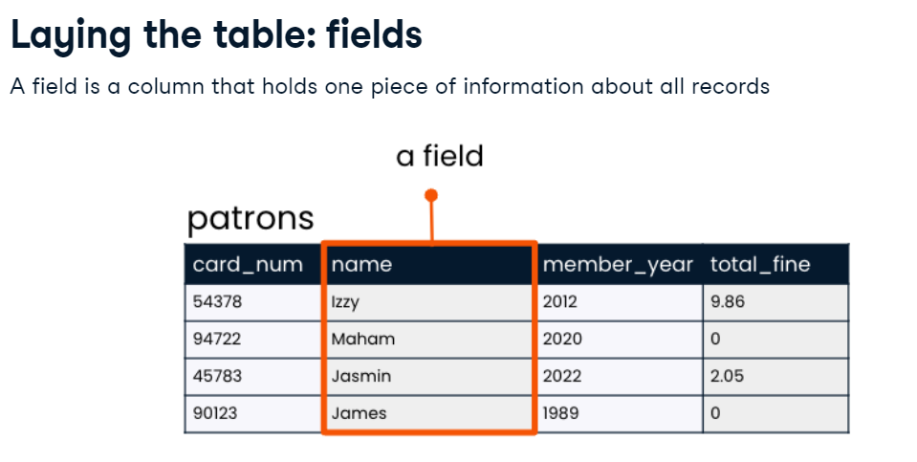

Slide 18
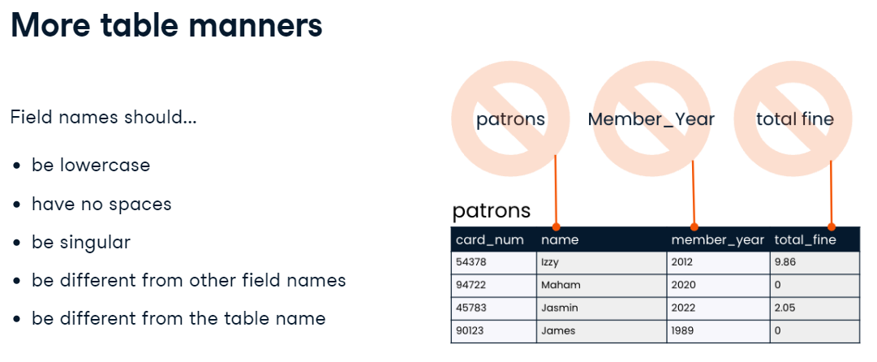

Slide 19
Some Theory Stuff…
What is a Record?
A complete set of information.
Records are composed of fields.
What is a field?
A space allocated for a particular item or information.
A collection of fields is called a record.

Slide 20
Examples Tables: Telephone Book Database

Slide 21
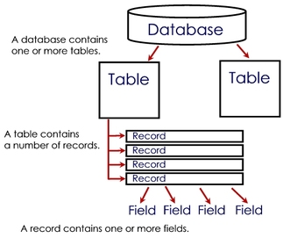
Overview of the Concept

Slide 22
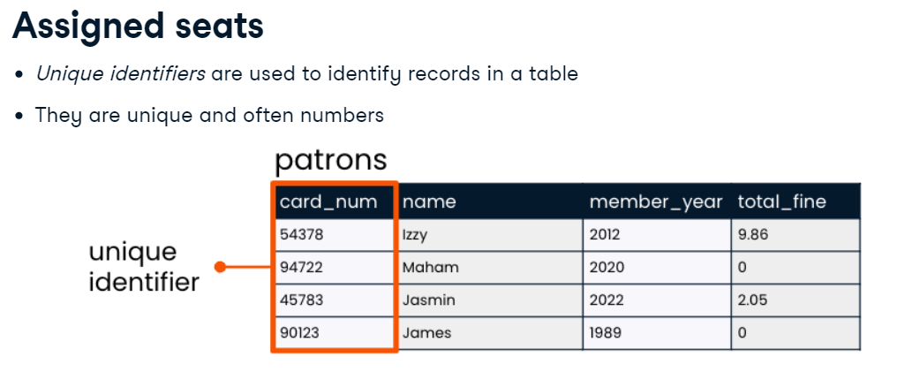

Slide 23
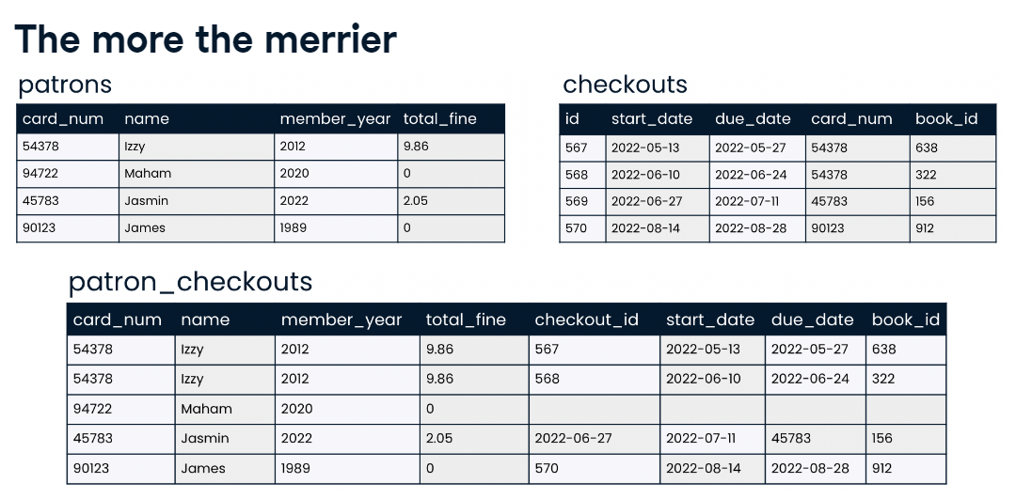

Slide 24
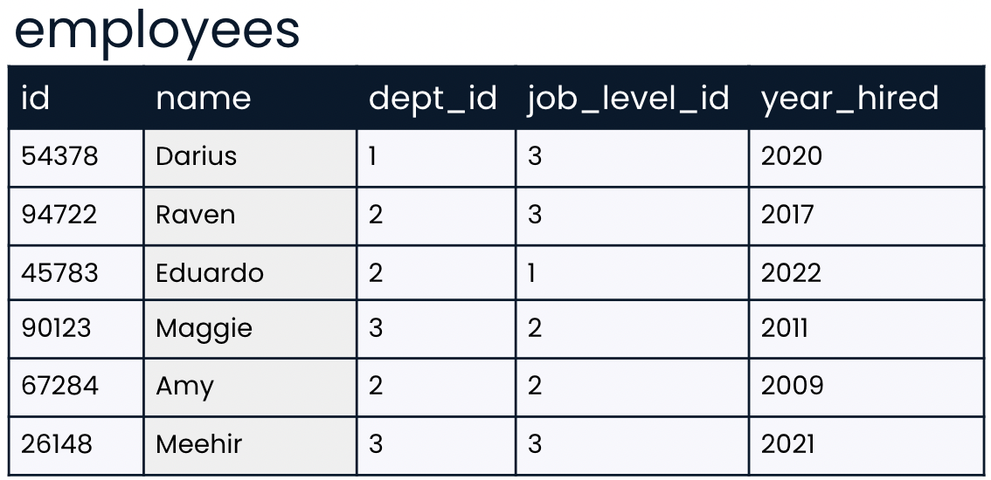
Quick Quiz # Picking a unique ID
You've learned that a unique identifier is a unique value that identifies a record so that it can be distinguished from other records in the same table.
Let's take a closer look at the employees table. Which of the fields do you think is best suited to be a unique identifier?
name
dept_id
id
job_level_id

Slide 25
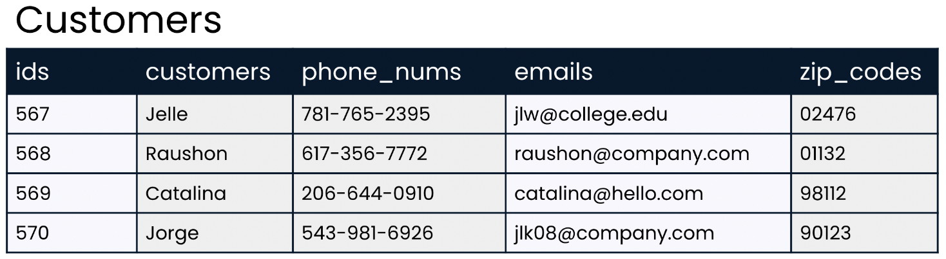
Quick Quiz # Setting the table in style
Imagine that you are designing a database and the following table has been suggested. Your task is to provide feedback on how this table could be improved. Use the skills you learned in the last video to critique it!
Table name should not be capitalized
The field name should be made singular
The customer field should be made singular
The field name should be capitalized
Underscore in the field names should be replaced with spaces.
The Table name should be made singular

Slide 26


Slide 27
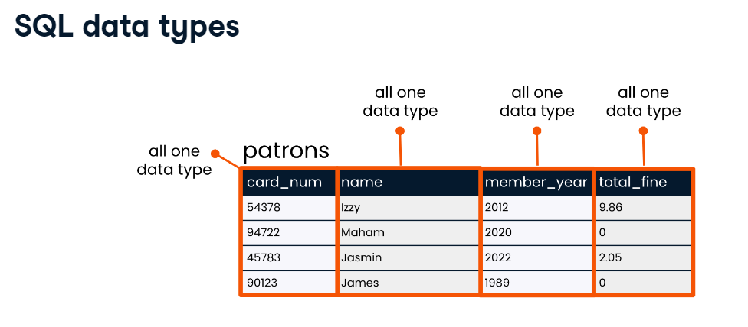
Different type of data are stored differently & take up different spaces.
Some operations only apply to certain data types.

Slide 28
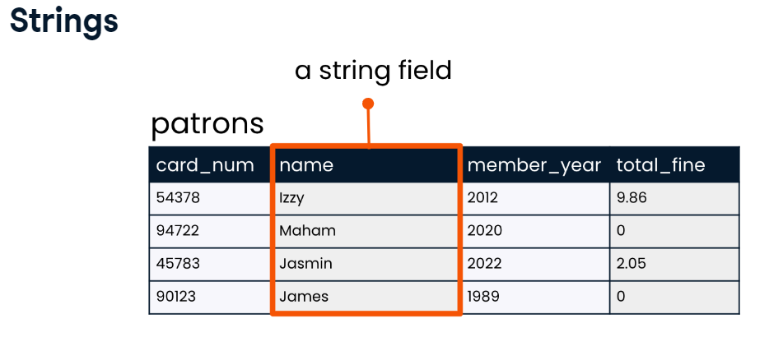
A string is a sequence of characters such as letter or punctuations.
VARCHAR is a flexible & popular string data type in SQL

Slide 29
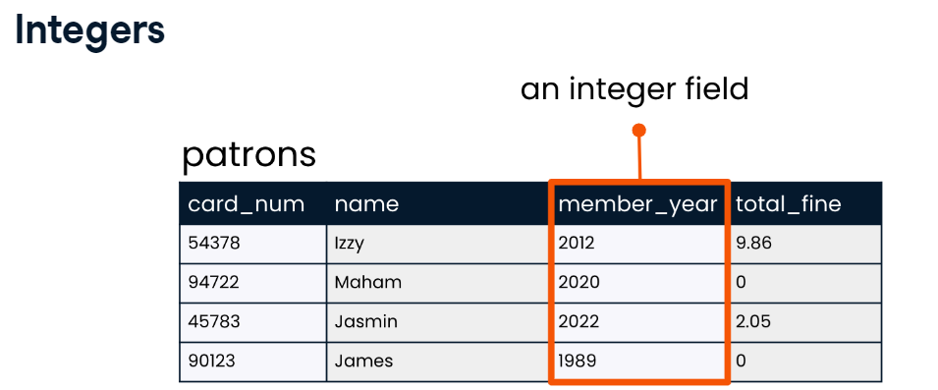
Integers store whole numbers
INT is a flexible & popular integer data type in SQL

Slide 30
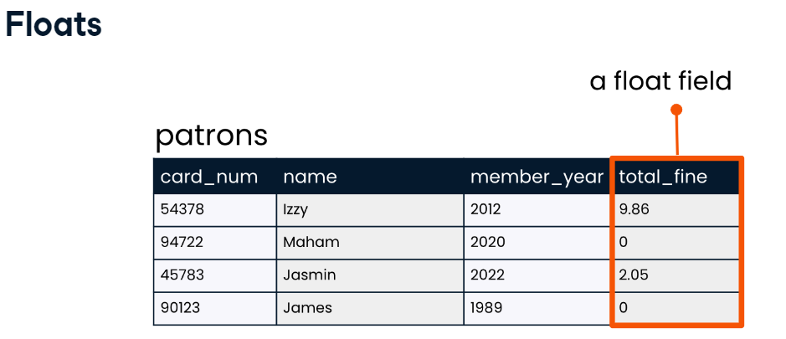
Float store numbers that store fractional part
NUMERIC is a flexible & popular float data type in SQL

Slide 31
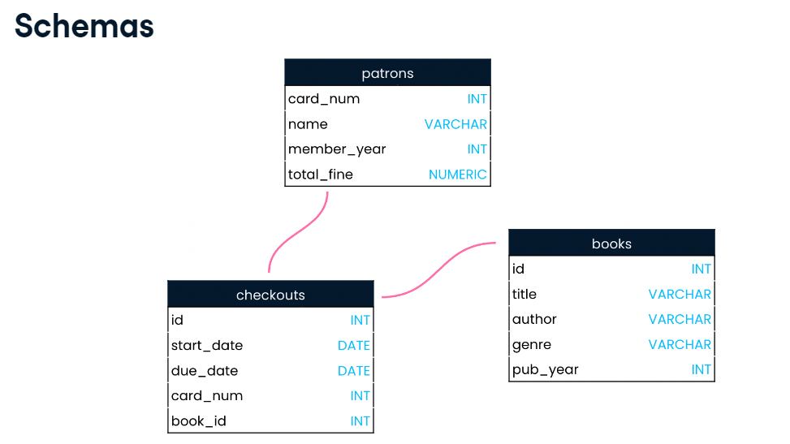
blue print of databases

Slide 32
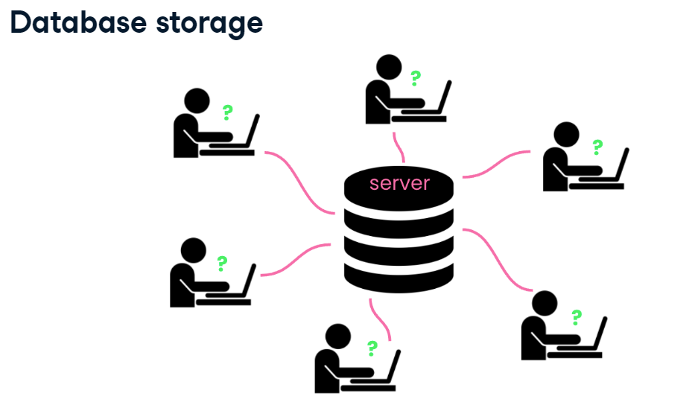
Servers are centralized computers that perform services via requests made over a internet
Used to access websites & files
Any computer can be a server (even computer can be also)

Slide 33
Quick Quiz # At your service
Now that you know more about how data is stored, it's time to test those skills!
Select the statement about database storage that is false.
Servers can be used for storing website information as well as databases.
A server can handle requests from many computers at once.
Servers are usually personal computers such as laptops.
Data from a database is physically stored on a server.
That's right! While it is technically possible for a laptop to be a server, laptops aren't well suited to the job since they are not powerful enough to handle many requests at once and don't have as much storage capacity as larger computers.

Slide 34
Quick Quiz # Finding data types
Imagine that you are starting a new job and have just started getting to know your new employer's database.
You know that it's important to know the data type—such as VARCHAR, INT, NUMERIC corresponding to each field in a table. Where could you find this information?
You can find this information by looking at each table in the database.
You can find this information by looking at a diagram of relationships between tables.
You can find this information by looking at the values in each field for each table.
You can find this information by looking at a database schema.
Awesome work. Database schemas show data types for each field in all tables, and they also show relationships between tables. Looking at a schema is an excellent way to get to know a new database!

Slide 35


Slide 36
Theory of Query
A query is a request for data or information from a database table or combination of tables.
A "query" refers to the action of retrieving data from your database. Usually, you will be selective with how much data you want returned.
The SELECT ... FROM Clause
The most basic SELECT statement has only 2 parts:
The columns you want to display and
From the table(s) these columns belong to.

Slide 37
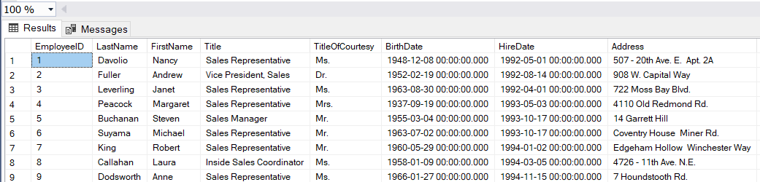
If we want to retrieve all of the information about all of the customers in the Employees table, we could use the asterisk (*) as a shortcut for all of the columns, and our query looks like Syntax: SELECT * FROM table_name; Example: SELECT * FROM Employees;

Slide 38
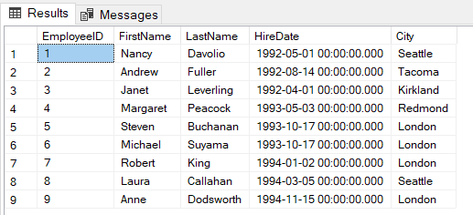
If we want to retrieve EmployeeID, FirstName, LastName, HireDate, City about all of the customers in the Employees table, our query looks like given below
Syntax
SELECT column1, column2, ... FROM table_name;
EXAMPLE:
SELECT EmployeeID, FirstName, LastName, HireDate, City
FROM Employees

Slide 39
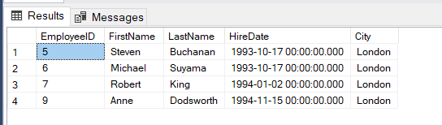
THE WHERE CLAUSE
The next thing we want to do is to start limiting, or filtering, the data we fetch from the database. By adding a WHERE clause to the SELECT statement, we add one (or more) conditions that must be met by the selected data.
Syntax :
SELECT column1, column2, ... FROM table_name WHERE condition;
EXAMPLE
SELECT EmployeeID, FirstName, LastName, HireDate, City
FROM Employees
WHERE City = 'London‘

Slide 40
Operator
An operator is a character or a reserved word that is used to specify a condition, or combine two or more conditions. The operators are used with the WHERE clause in the SELECT statement to set the filter criteria for data.

Slide 41
Comparison Operator
Comparison operators are used to compare the column data with specific values in a condition.
Comparison Operator Description
= Equal to
> Greater than
< Less than
>= Greater than or equal to
<= Less than or equal to
<> Not equal to

Slide 42
SQL WHERE and OPERATOR Syntax
SELECT column_name,column_name
FROM table_name
WHERE column_name operator value

Slide 43
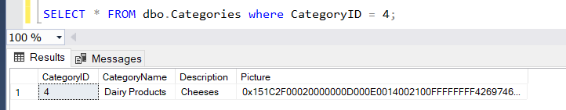
Equal to
SELECT * FROM dbo.Categories
where CategoryID = 4;

Slide 44
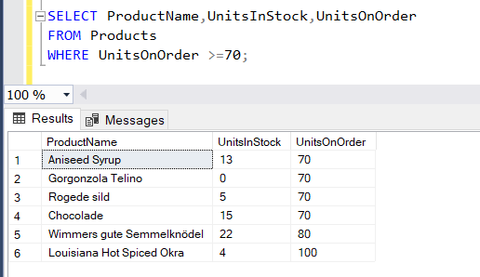
Greater than or equal to
SELECT ProductName,UnitsInStock,UnitsOnOrder
FROM Products
WHERE UnitsOnOrder >=70;

Slide 45
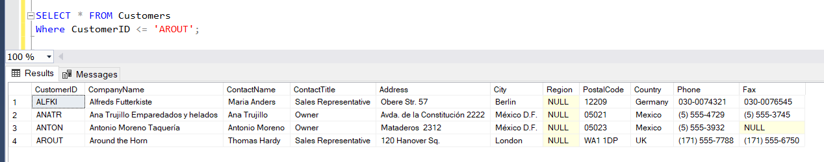
Less than equal to
SELECT * FROM Customers
Where CustomerID <= 'AROUT';

Slide 46
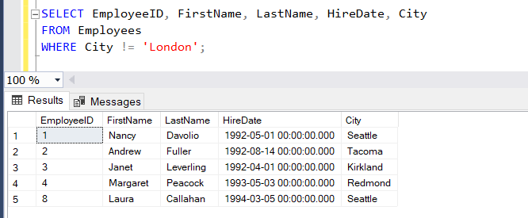
Not equal to
SELECT EmployeeID, FirstName, LastName, HireDate, City
FROM Employees
WHERE City != 'London';

Slide 47
DISTINCT Statement
The SELECT DISTINCT statement is used to return only distinct (different) values.
Inside a table, a column often contains many duplicate values; and sometimes you only want to list the different (distinct) values.
Syntax:
SELECT DISTINCT column1, column2, ... FROM table_name;

Slide 48
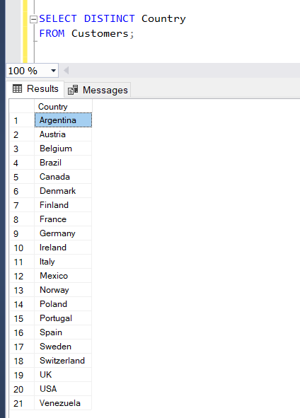
Example
SELECT DISTINCT Country
FROM Customers;

Slide 49
DOWNLOAD LINK
SQL MANAGEMENT STUDIO
https://docs.microsoft.com/en-us/sql/ssms/download-sql-server-management-studio-ssms?view=sql-server-ver15
SQL SERVER EXPRESS
https://www.microsoft.com/en-us/sql-server/sql-server-downloads

